Slide 1

CS470 Final Project
Bryan Richlinski, Conner Keiter, Irvin Jimenez-Solis, Tristan Whaley, Vien Nguyen

Slide 2
About Our Database
World Cup game data archive
Teams
Players
Games
Scores
Awards
MySQL
Amazon Web Service

Slide 3
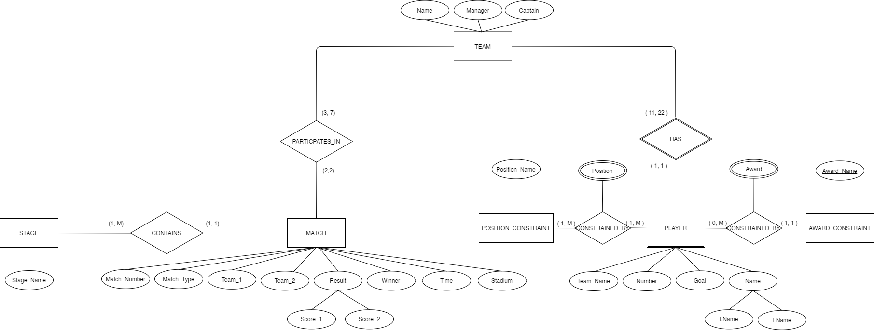
ER Diagram

Slide 4
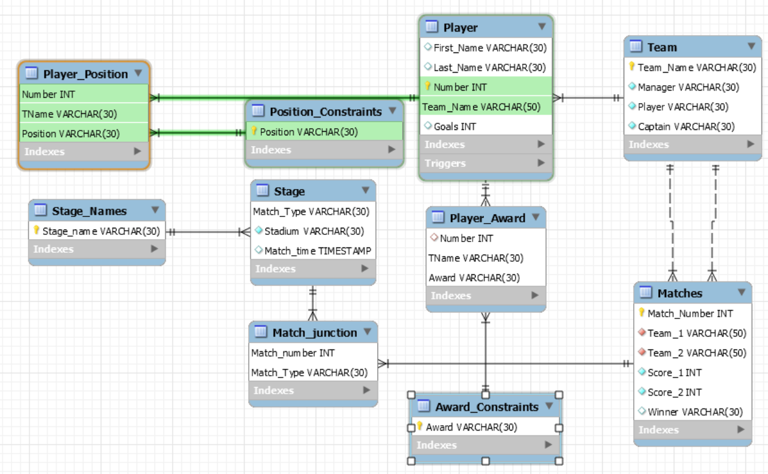
Schema Diagram

Slide 5
Common Queries
Team roster
Score for group phase
What group is team x in
What was the highest score of all teams
How many games ended in a tie
What are the total wins, losses, and ties for a team
What team made it to the knockout rounds

Slide 6
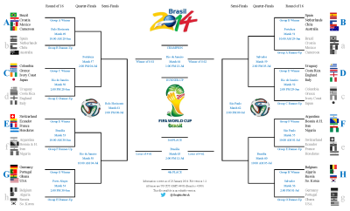
Constraints
There cannot be more than 22 players per team
If team A is in group stage x, then team A cannot also be in group stage y where x != y
There cannot be more than 6 matches per group
A team must have the top 2 scores in their group stage to proceed to 16 round
There cannot be more than 4 teams per group stage
There cannot be more than 8 games from stage 16
A team cannot play itself
There cannot be more than 4 games in quarter finals
There cannot be more than 2 games in the semi-finals
There cannot be more than 1 game called finals
No constraints for who can win awards
Only top teams form group stage can proceed to knockout round
Knockout rounds cannot have ties
No constraints that limit the number of goals in the player table

Slide 7
Deficiencies
No capability to store multiple years worth of game data.
Difficulty importing date time stamps.
Add separate front end for data entry.
Didn’t check normalization.
No trigger to match scores and goals.
No trigger to enforce who can receive awards.

Slide 8

Future Scope
Add all data of world cup events that were operated.
User experience design needed.
Improve structure for future modal change in 2026.

Slide 9
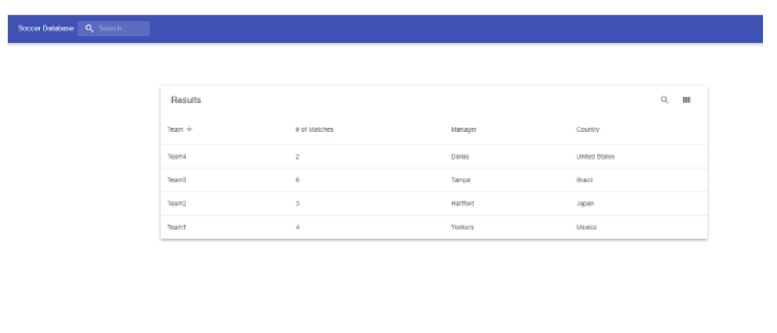
User Interface
Our front end is scripted in JavaScript Node.js and HTML
When a user enters a query the table will be populated with the requested results
Longer lists of results can be searched for more specific results

